Slide 1
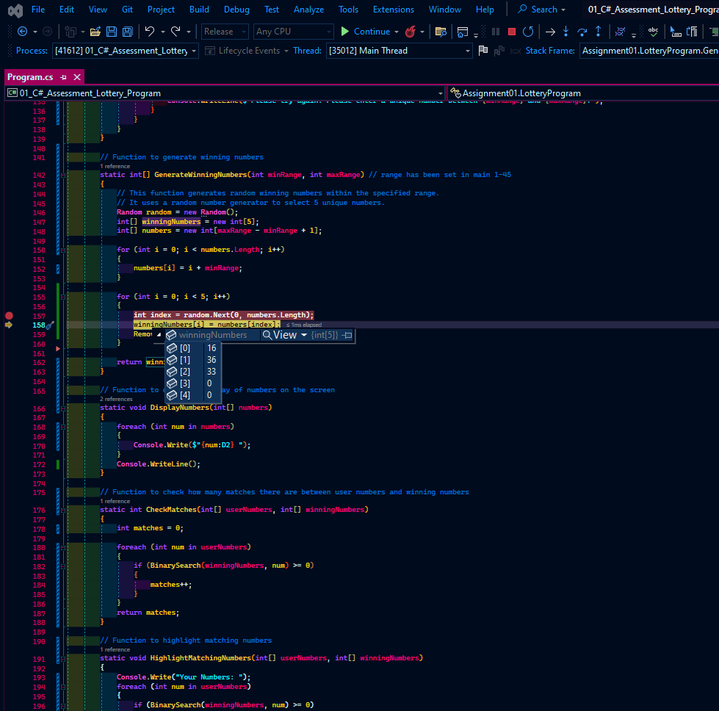
Updated 21st October 2023
C# Part 1 – Lottery Program | Task 2 – Debugging

Slide 2
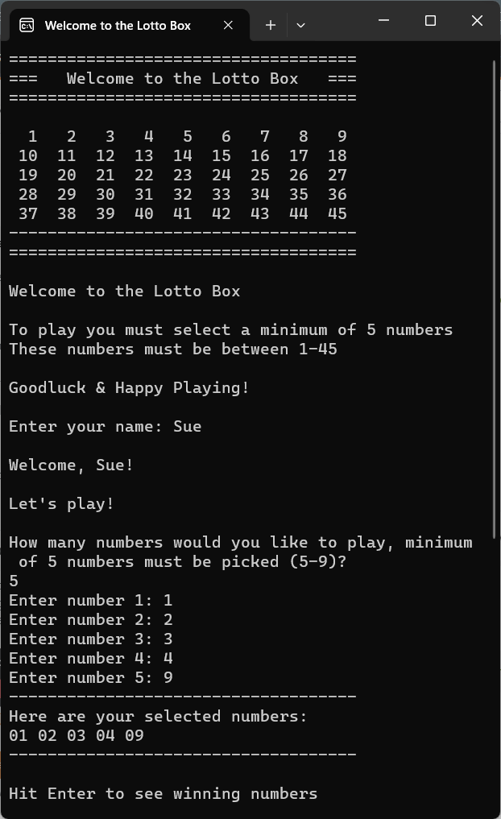
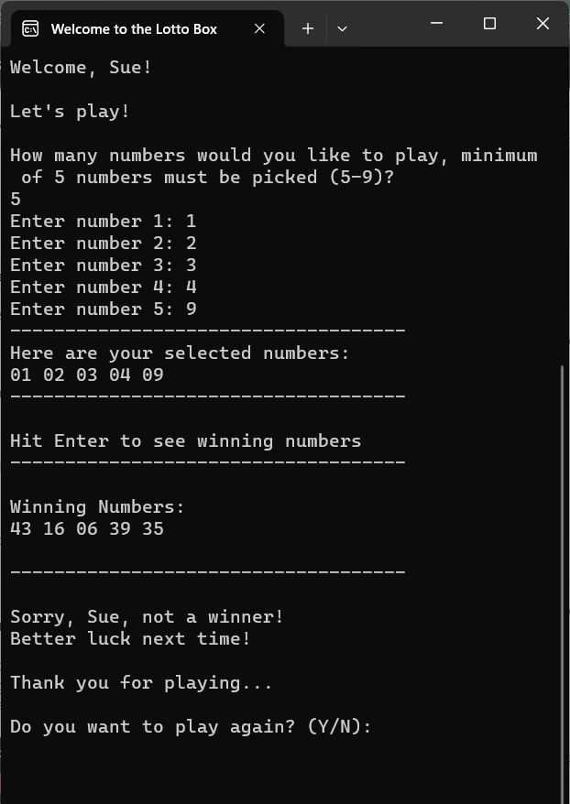
Updated 21st October 2023
C# Part 1 – Lottery Program | Task 6 – Debugging

Slide 3
Updated 21st October 2023
C# Part 1 – Lottery Program | References
SOLUTION REFERENCE:
TAFE C# SLIDES
// SOLUTION REFERENCE:
// COMPILER ERROR CS0029 - https://learn.microsoft.com/en-us/dotnet/csharp/language-reference/compiler-messages/cs0029?f1url=%3FappId%3Droslyn%26k%3Dk(CS0029)
// INTEGER BOOL CHECK AND ERROR MSG - https://stackoverflow.com/questions/72400895/c-sharp-input-validation-for-strings-and-integers
// CONSOLE.WRITELINE VS CONSOLE.WRITE - https://stackoverflow.com/questions/22845664/how-do-i-print-text-in-same-line
// BOOLEEN OPERATORS - https://education.launchcode.org/intro-to-programming-csharp/chapters/booleans-and-conditionals/logical-operators.html#:~:text=C%23%20allows%20us%20to%20create,the%20overall%20expression%20is%20False%20.
// RANDOM GENERATOR - https://www.tutorialsteacher.com/articles/generate-random-numbers-in-csharp
// RANDOM GENERATOR + LOOPS - https://www.youtube.com/watch?v=9ozOSKCiO0I&list=PLPV2KyIb3jR4CtEelGPsmPzlvP7ISPYzR&index=5
// LINEAR SEARCH - https://www.geeksforgeeks.org/check-if-two-arrays-are-equal-or-not/
// LINEAR SEARCH - https://www.youtube.com/watch?v=vYSdsBgFji8
// LOTTO NUMBER BOX - https://chat.openai.com/share/ac2eeb5f-d945-41af-99cc-e61ec15d6f11
// THREAD SLEEP
// https://www.tutlane.com/tutorial/csharp/csharp-thread-sleep#:~:text=In%20c%23%2C%20the%20sleep%20method,property%20like%20as%20shown%20below.
// https://www.geeksforgeeks.org/suspending-the-current-thread-for-the-specified-amount-of-time-in-c-sharp/
// REPLAY THE PROGRAM - https://chat.openai.com/share/92241e6c-3217-450b-8a84-c39a23d718f3
// RESIZE THE SCREEN - https://www.geeksforgeeks.org/console-setwindowsize-method-in-c-sharp/
// BINARY SEARCH - https://chat.openai.com/share/30f51733-1b58-449f-a25b-c4dbd9785ac1

